Slide 1
Lecture 10
Application of NLP in Chatbots

Slide 2
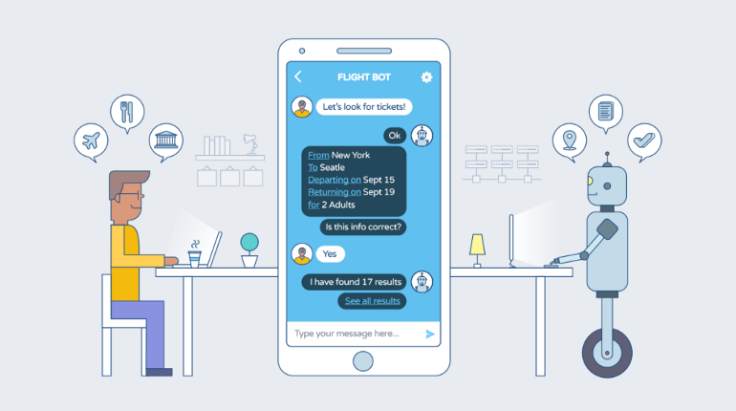
Chatbots
Chatbot is a simulation which can understand human language, process it and interact back with humans while performing specific tasks.

Slide 3
Chatbots
For example, a chatbot can be employed as a helpdesk executive.
The first chatbot was created by Joseph Wiesenbaum in 1966, named Eliza.
It all started when Alan Turing published an article named “Computer Machinery and Intelligence”, and raised an intriguing question, “Can machine think?”, and ever since, we have seen multiple chatbots surpassing their predecessors to be more naturally conversant and technologically advanced.
These advancements have led us to an era where conversations with chatbots have become as normal and natural as with another human.

Slide 4
Chatbots
Today, almost all companies have chatbots to engage their users and serve customers by handling their queries.
By 2020, Gartner estimated that chatbots will be handling 85% of customer-service interactions. Also, 80% of businesses are expected to have some sort of chatbot automation by 2020 (Outgrow, 2018).

Slide 5
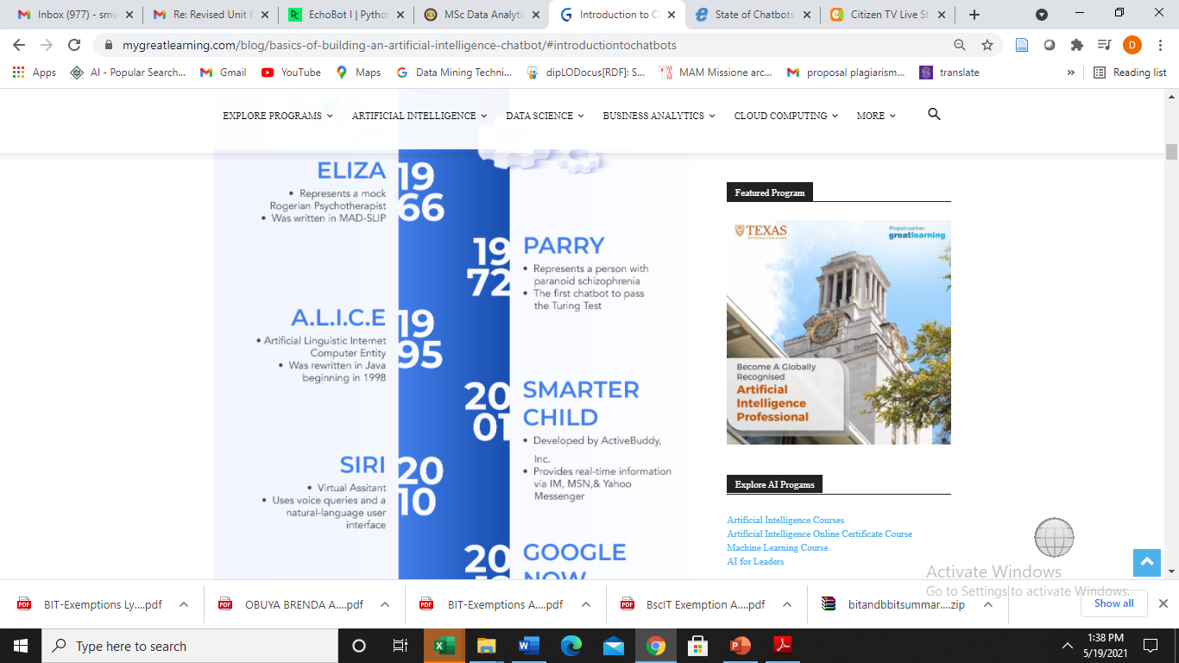
History of Chat bots

Slide 6
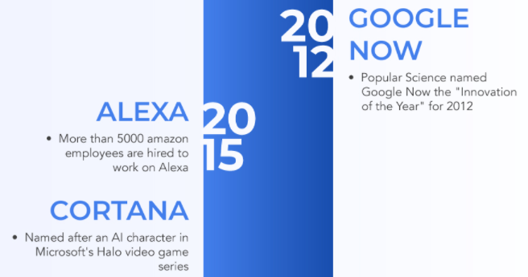
History of Chat bots

Slide 7
Benefits of Chatbots
Chatbots helps any business/organization in accomplishing the following goals:
  Increases operational efficiency.
  Automating customer request fulfillment.
  Handling basic queries, which in turn free employees to work for complex & higher value inquiries.
  Offers Multi-language support.
  Saves time & effort by automating customer support.
  Improves the response rate as well as customer engagement.

Slide 8
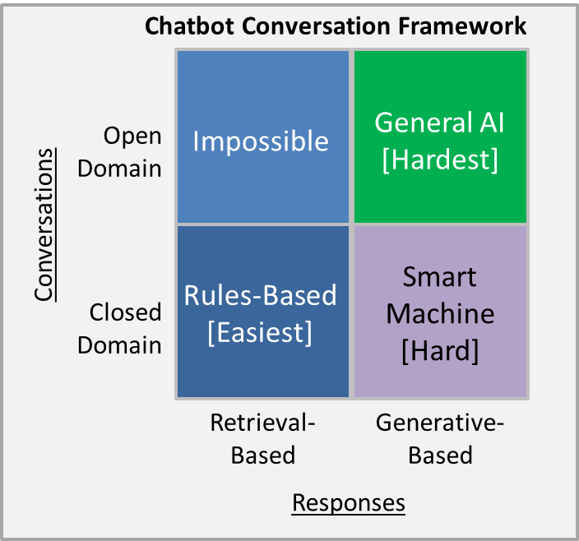
Chatbot models
Generative models: Generate new responses from scratch. They are typically based on Machine Translation techniques (e.g. using LSTM), but instead of translating from one language to another, we “translate” from an input to an output (response).
Retrieval-based model: retrieves the answers/responses from a set of predefined responses and some kind of heuristic to pick an appropriate response based on the input and context.
Reference:
https://medium.com/deep-math-machine-learning-ai/chapter-11-chatbots-to-question-answer-systems-e06c648ac22a

Slide 9
Domain of applications
There are two types of Application domains for chat bots:
Open domain is the place where the chat conversation can go anywhere, users can type/ask anything. There isn’t necessarily have a well-defined goal or intention. An example is chatbot mitsuku .
Closed domain is the place where you are solving a particular business problem ( The business could be in any sector/industry )
ex : Pizza bot, Bankingbot, Medical bot, CricketScore bot etc…

Slide 10
Classification of Chatbots
There are several criteria of classifying chatbots.
Content format classification
Design Approach classification
Complexity level classification
Application based classification

Slide 11
Content format classification
Content format classification categorizes chatbots into two groups
Text-based chatbot answers the user’s questions via text interface.
Voice-based chatbot or speech-based chatbot, answers the user’s questions via a human voice interface.

Slide 12
Complexity level classification
Complexity level classification categorizes chatbots into three classes:
Traditional chatbot: are driven by system and automation, mainly through scripts with minimal functionality and the ability to maintain only system context.
Current chatbot: are driven by back and forth communication between the system and humans. They have the ability to maintain both system and task contexts.
Future chatbots can communicate at multiple levels with automation at the system level. They have the ability to maintain the system, task, and people contexts. There is a possibility of introduction of master bots and eventually a bot OS.

Slide 13
Design Approach classification
Design Approach classification categorizes chatbots into groups:
1. Rule-based approach enable a bot to answer questions based on some rules on which it is trained on. The rules defined can be very simple to very complex. The bots can handle simple queries but fail to manage complex ones.
2. Self-learning bots allows the bot to use some Machine Learning-based approaches This approach is more efficient than rule-based approach. These bots can be further classified in two types:
Retrieval Based bots or Generative
  3. NLP (Contextual) Chatbots are combination of best from rule-based and self learning approaches. Therefore, they are the most advanced chatbots. They use NLP to understand the context and intent in users' requests and thus act accordingly. These chatbots can handle multiple requests from the same user at ease.

Slide 14
Application Based classification
Application Based classification defines several categories of chatbots
Virtual reception assistant
Virtual help desk assistant
Virtual tutor or teacher
Virtual driving assistant
Virtual email, complaints, or content distributor
Virtual home assistant [example: Google Home]
Virtual operations assistant [e.g. Jarvis from the movie Iron Maiden]
Virtual entertainment assistant [example: Amazon Alexa]
Virtual phone assistant [example: Apple Siri]
Assist the visually impaired person to describe surroundings
Can help a warehouse executive in locating the stocked product

Slide 15
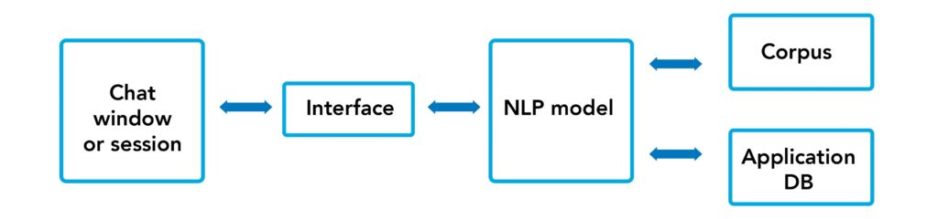
Architecture of chatbots
Chatbot architecture should consist of the following:
front end application interface: Chat window or session
The deep learning model: for Natural Language Processing model
Corpus or training data for training the NLP model
Application Database for processing actions to be performed by the chatbot

Slide 16
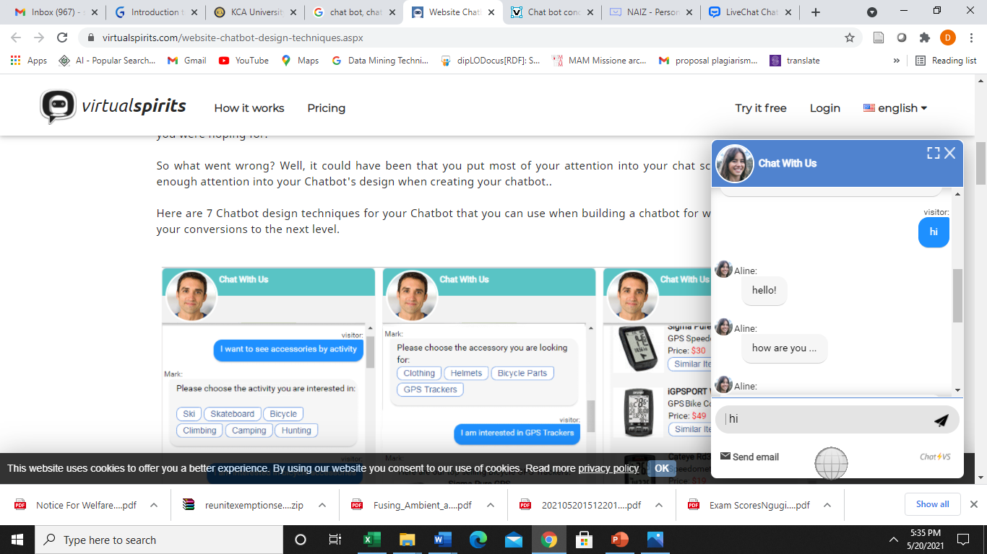
Chat Window
Chatbot window enables the user to interact with bot using text.

Slide 17
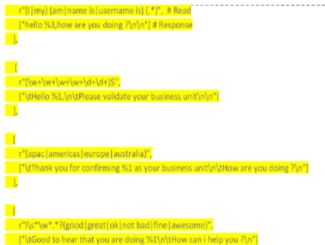
Corpus or Training Data
Corpus or Training Data is the data that could be used to train the NLP model to understand the human language as text or speech and reply using the same medium.
Corpus is usually huge data with a lot of human interactions .
Corpus can be designed using Manual method or accumulated over time in an organized fashion.
Example

Slide 18
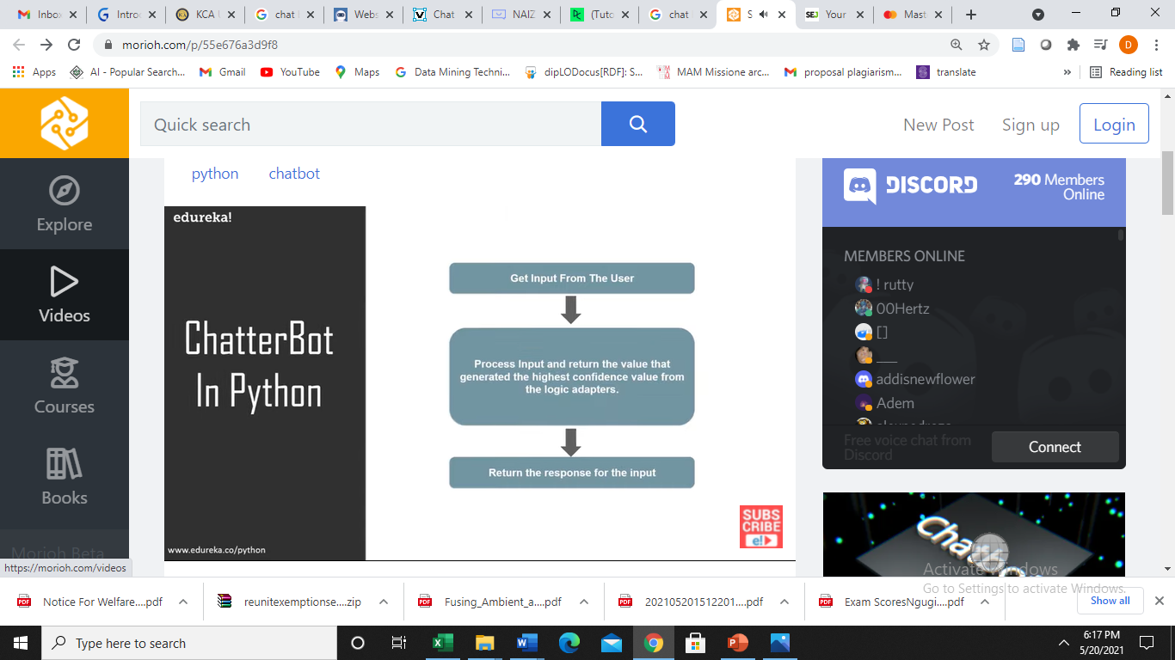
Basic algorithm

Slide 19
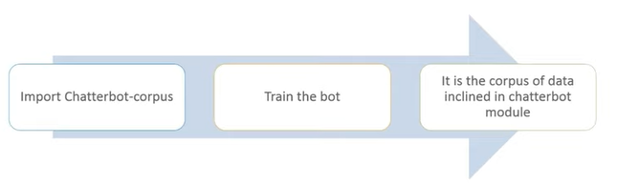
Training the Chatbot

Slide 20
Algorithm for chat Bot
1. Import Corpus
2. Data pre-processing:
Text handling, Tokenization, Stemming
Generate BOW (bag of words), Generate one hot encoding for the target column
3. Develop classifier model through machine learning techniques: e.g. Multinomial Naïve Bayes, Support Vector Machine[SVM], Neural network classifier etc.
4. Develop a chat window as a function to interact with the user
5. Test the chatbot by running

Slide 21
Chatbot building Platforms
Chatbots platforms enable developers to create customized chatbots:
1. ChatterOn
2. Chatterbot
2. Azure Bot Service:
3. Botsify:
4.Amazon Lex:
5. Mobile Monkey:
6. TARS:

Slide 22
1. ChatterOn
Chatteron can handle different types of rich content responses from the Bot as it allows developers to connect different APIs at each interaction with the user.
ChatterOn offers more than 20 pre-built bots that can be put to use in a single click.
It doesn’t require much coding, which makes it easier for non-technical users to build chatbots.
https://www.datacamp.com/community/tutorials/building-a-chatbot-using-chatterbot

Slide 23
2. Chatterbot
Chatterbot is a python library specifically designed to generate chatbots.
This library uses a selection of machine learning algorithms to fabricate varying responses to users as per their requests.
Chatterbot makes it easier to develop chatbots that can engage in conversations.
It starts by creating an untrained chatterbot that has no prior experience or knowledge regarding how to communicate.
As the users enter statements, the library saves the request made by the user as well as it also saves the responses that are sent back to the users.
As the number of instances increases in chatterbot, the accuracy of the responses made by chatterbot also increases.

Slide 24
2. Chatterbot
Chatterbot is trained to search the closest analogous response by finding the closest analogous request made by users that is equivalent to the new request made.
Then it selects a response from the already existing responses.
Chatterbot enables developers to create their own dataset and structures at ease.

Slide 25
Building Chatterbot
Step one: Preprocessing
Select and Install necessary resources:
chatter bot library, corpus,
Step Two: Create Classifier model
- Define Chatbot object
Step Four: Training the chatbot
Step Four: Test the chatbot
https://towardsdatascience.com/beginners-guide-to-creating-a-powerful-chatbot-48fc6b073e55

Slide 26
References
https://www.datacamp.com/community/tutorials/building-a-chatbot-using-chatterbot
https://data-flair.training/blogs/python-chatbot-project/
https://www.mygreatlearning.com/blog/basics-of-building-an-artificial-intelligence-chatbot/#introductiontochatbots
https://www.eweek.com/big-data-and-analytics/state-of-chatbots-in-2018-rapidly-moving-into-the-mainstream/
https://campus.datacamp.com/courses/building-chatbots-in-python/chatbots-101?ex=2

Slide 27


Questions?

